Slide 1
Android based smart heart monitoring system

Slide 2
Project Guide:
Members:
Ms. D. Brindha
Akash J
Harshavardhan J
Parthasarathy B

Slide 3
Table of contents:
Abstract
Objective
Introduction
Block diagram
Platforms used
Our module
Conclusion

Slide 4
ABSTRACT:
Electrocardiogram (ECG) is a very powerful medical device, especially for heart related issues. It helps to understand how the heart works, and gives a helping hand in diagnosis of heart related problems, which is becoming very important in modern era. In this paper, we are proposing a portable android based device which is capable to store ECG signal through wireless medium for a long time for predicting the heart related ailments and also to act as a prior warning system for the user.
We are going to implement using Android Device And Smart Watches for Bluetooth communication to make it portable and wireless. And we are using Cloud Storage to record the real-time data which can be used to diagnose a disease or arrhythmia. It can display the real time ECG in the smart phone to the user, by the help of an android app made using Android app.

Slide 5
Objective:
Mobile computing platforms are going to dominate the information communication technology (ICT) sector in this age of rapid technological innovations.
Mobile computing devices especially smart phones are complex communication and computing devices which have surpassed desktop PCs in terms of worldwide sales in just few years .
Nowadays, cardiac diseases are increasing in an alarming rate. According to the World Health Organization (WHO), cardiac disease is one of the leading causes of death in the developing world and is the leading cause in the developed world

Slide 6
Mobile phones are already being used for increasing the effectiveness of public health programmers and managing/treating chronic diseases.

Slide 7
Introduction:
Heart related disease are main reason for death globally.
By using ECG sensor, we can diagnose these diseases and we can predict the diseases in advance.
So, they help us to take necessary actions immediately before its too late.
So, an ECG machine to keep monitoring a person's health is very useful and can bring down deaths globally.
Electrocardiogram, also known as ECG, is and instrument which measures the electrical activity of the heart.
ECG gives a good picture of the heart's working.

Slide 8
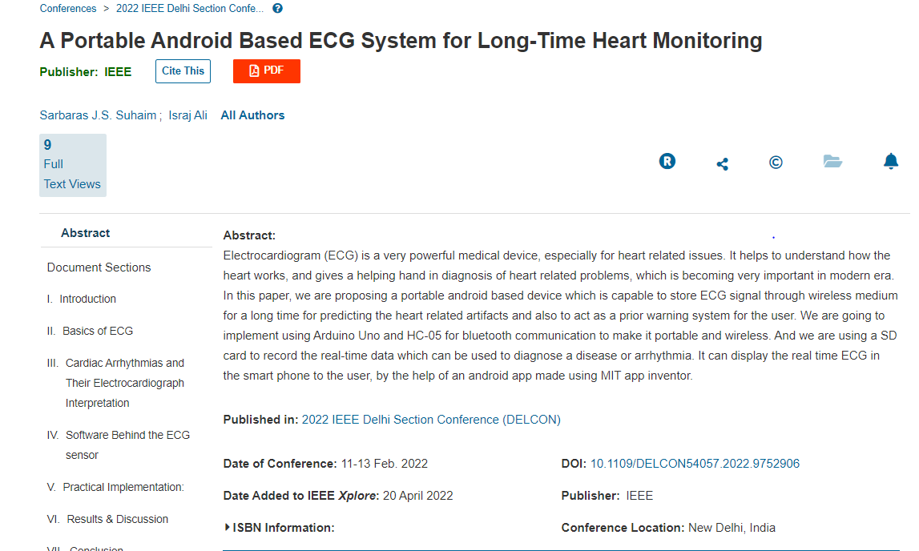

Literature survey
Literature survey

Slide 9
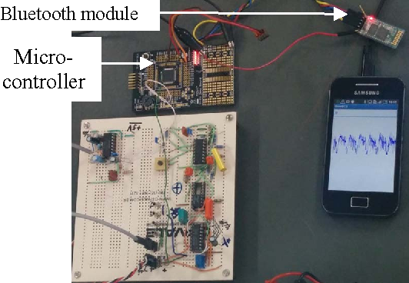

Existing System

Slide 10
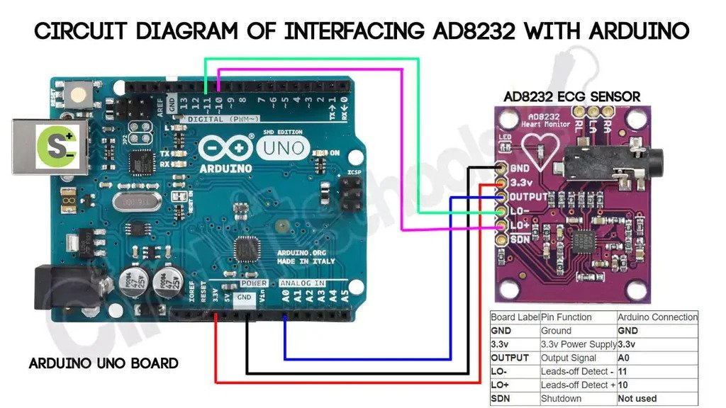

Block diagram
Block diagram

Slide 11
Disadvantages
ECG signals may be corrupted by various kinds of noise.
Not Portable
Cost is High

Slide 12
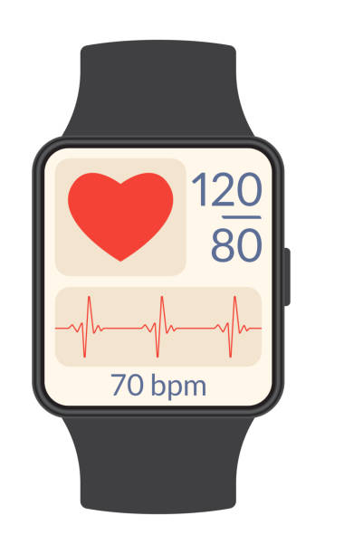
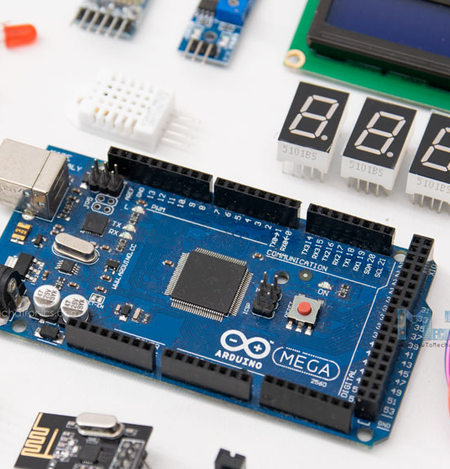

Why Smart Bands / Watches over Arduino ?

Slide 13



Time SIMPLE COST

Slide 14
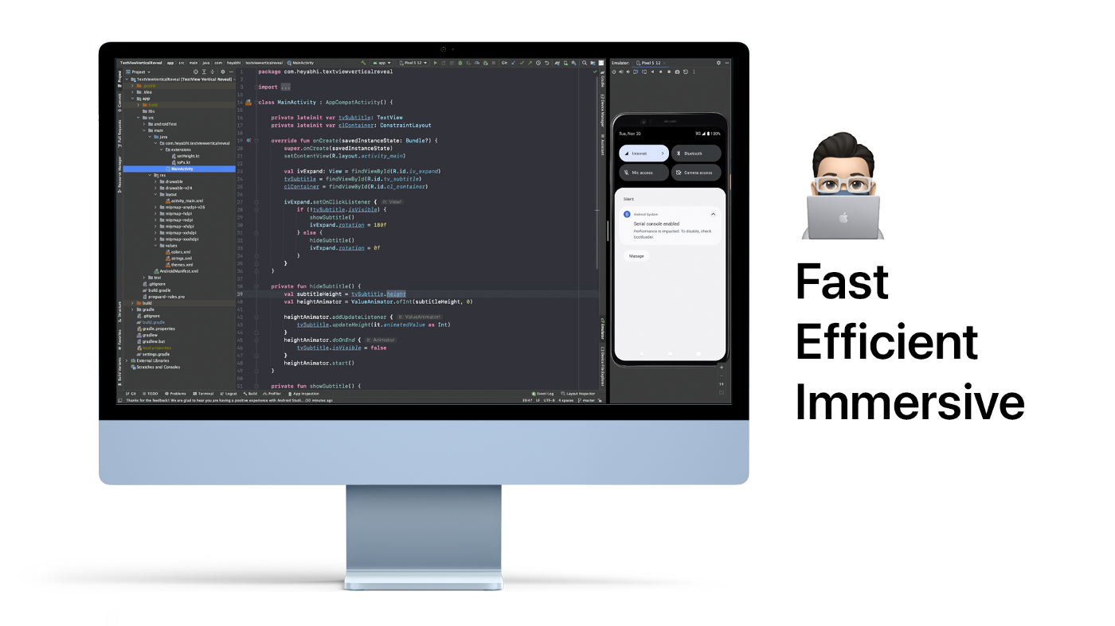
Also Comparing The Programming Part

Slide 15



Proposed System – Module Platforms used

Slide 16
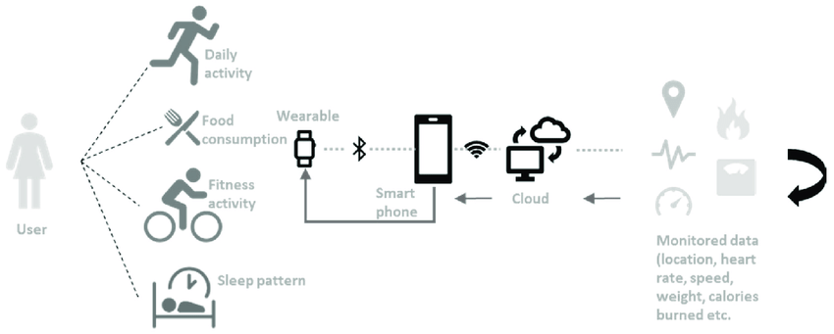
Block diagram:

Slide 17
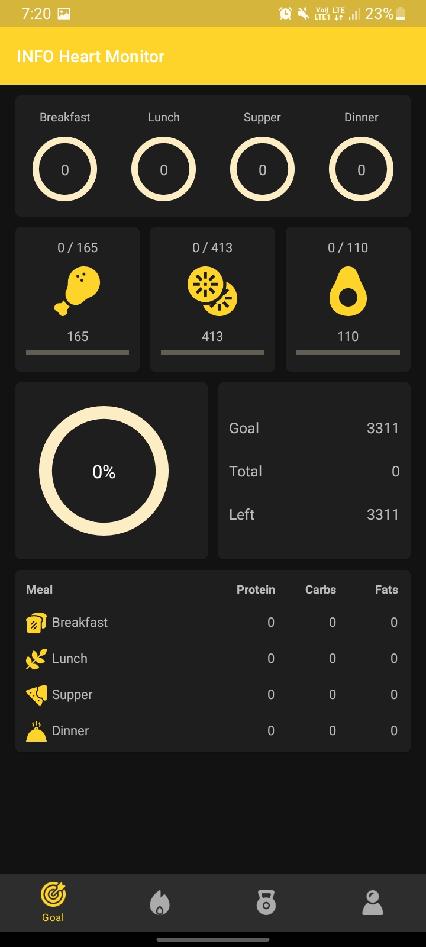
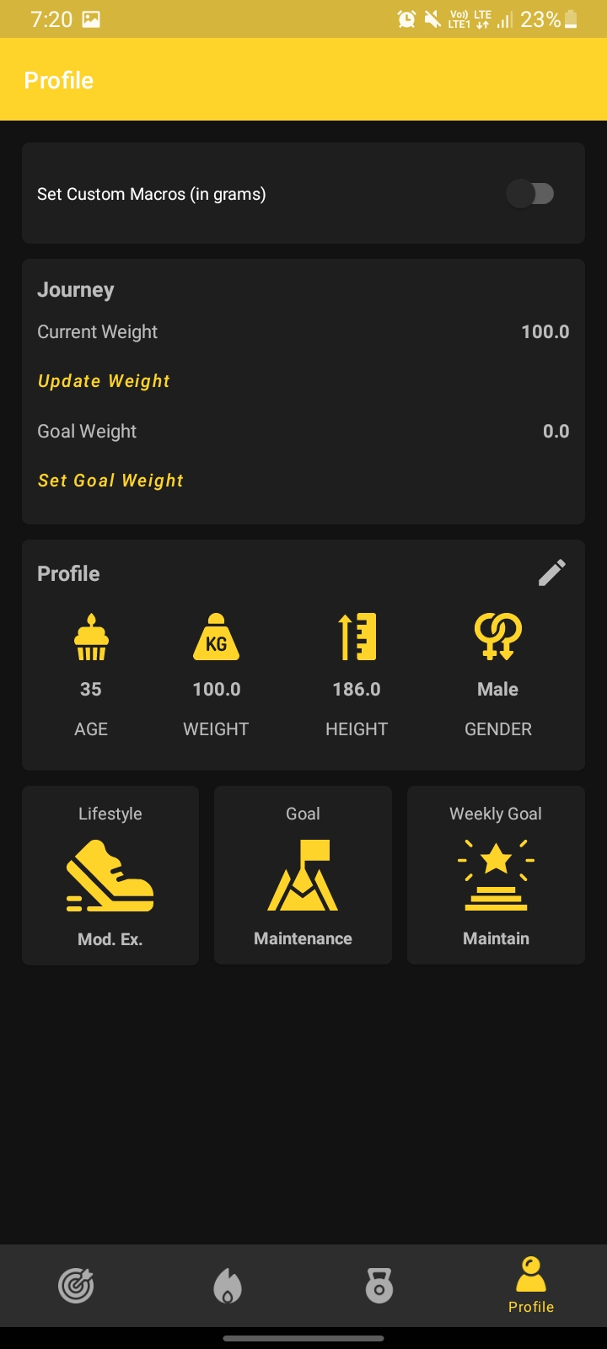
Our module :

Slide 18
Conclusion:
The objective of this thesis was to develop a compact ECG monitoring device. All the steps for the development of this project have been described in this thesis. We have discussed every aspect of the project from analog front end design to Android phone application which is the most significant part of the project. Struggle for design of analog front end has shown new ways of signal processing. We have tried to present a clear ECG signal keeping in view all bandwidth and noise requirements. The advancement in mobile and wireless health care solutions is contributing in different aspects of our lives that range from diagnosis to treatment of different diseases like cardiovascular disease. Android applications are also a part of diverse solutions that are offered as healthcare solutions together with a variety of health monitoring devices.. The result of the project has achieved part of the objectives that were set at the beginning. The bachelor’s thesis was an opportunity to extend and discover new skills in Mobile application development. The final result of the application can also be adapted as a reference for Bluetooth application development in the android platform. The Paper lays out a foundation for future developments that are focused on wireless health solutions in the android platform.

Slide 19
[1] B.A. Walker, A.H. Khandoker, & J. Black, “Low cost ECG monitor for developing countries”, in Fifth International conference on Intelligent Sensors, Sensor Networks and Information processing (ISSNIP), pp 195-200, December 200.
[2] http://www.bgstar.com/web/ibgstar
[3] Nursecom Educational Technologies, “An ECG Primer”.
[4] http://www.classes.usc.edu/engr/bme/620/LectureECG Noise.pdf
[5] http://www.cis.hut.fi/Opinnot/T61.181/s04/local/aksela.ppt
[6] http://en.wikipedia.org/wiki/Ensemble_average
[7] http://en.wikipedia.org/wiki/Sallen-Key_topology
[8] www.ti.com/lit/ds/symlink/tl071a.pdf
[9] http://en.wikipedia.org/wiki/Bluetooth
[10]http://www.microchip.com/wwwproducts/Devices.aspx ?dDocName=en558330
[11]www.ti.com/mspvalue-g2xx-pr-td
[12] android-developers.blogspot.com
Reference:

Slide 20
Thank You!
Any questions?

